Slide 1
Sedimentation Tank Remainder
Capstone Design 2017
Team SYM
Melanie Lim
Shiyao Sun

Slide 2
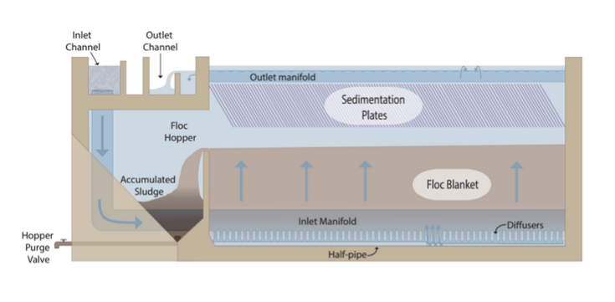
To create a sed tank:
Geometric Constraints
Hydraulic Constraints
Notes:
Goal / Importance
When designing a sedimentation tank, dimensions and parameters of the tank are determined from constraints, which can be divided into two main types: geometry and hydraulics
Geometric Constraints: handled in Fusion 360
Slope for floc slide-down
Depth of floc blanket
Area of the lost triangle of space at the end of plate settlers
Inlet and outlet channels
Hydraulic Constraints: Hydraulic-determined parameters are calculated in Python
Diameter of inlet and exit manifold pipes
Diameter of diffusers, orifices
Length of plate settlers
Goal: to determine the key parameter in each component, and the calculations required to design these hydraulic constraints

Slide 3
Design Steps
Diffusers
Inlet Manifold
Plate Settlers
Outlet Orifices
Notes:
Design Steps:

Slide 4
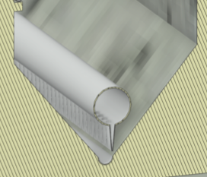
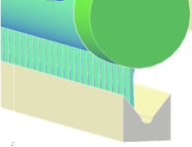
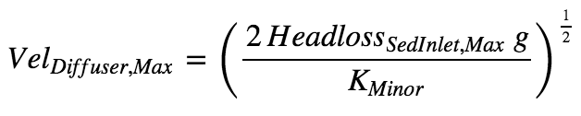
Diffusers
Assumptions & Inputs
Head loss exiting diffusers
Nominal diameter
PVC Stretch
Upflow velocity
SDR
Diffusers
Notes:
Analysis methods and description of key constraints:
Using head loss at the exit of the diffusers as design constraint for the design of the inlet manifold/diffuser system. This head loss in the exit of the diffuser will allow higher velocities (and pressure recovery) in the manifold pipe and thus will enable use of smaller diameter manifold pipes.
Diffusers
Maximum head loss in the sedimentation tank inlet is 1 cm
Nominal diameter of the sed tank diffuser = 1 inch
The diffuser pipes used in the sedimentation tank have an SDR of 26.
Stretch of the PVC pipes as they are heated and molded = 1.2
Upflow velocity at the top of the floc blanket (V_sed_up = 1 mm/s)
Inlet Manifold
Length of sed tank / PVC pipe used to make the inlet manifold = 6 m
Head loss exiting the tank is 5 cm
The manifold used in the sedimentation tank has an SDR of 41.
The minimum port flow (from the first port) divided by the maximum port flow (from the last port) for flow division between sedimentation tanks and for flow distribution from the inlet manifold should be at least: Q_ratio = 0.8
Plate Settlers:
Upflow velocity at the top of the floc blanket (V_sed_up = 1 mm/s)
Dimensions of the corrugated plastic sheets used to make the plate settlers:
Width = 42 inches
Thickness = 2 mm
Plate settlers angle = 60° from the horizontal
Plate setters spacing 2.5cm apart (this is the perpendicular distance between plates, not the horizontal)
Plate settler capture velocity = 0.12 mm/s
Orifices in the Outlet Manifold
Design temperature to calculate viscosity is 15 deg C
Minor loss coefficient to be K = 1
Vena contracta (VC) is 0.63
Spacing between orifices in the outlet manifold is 10 cm

Slide 5
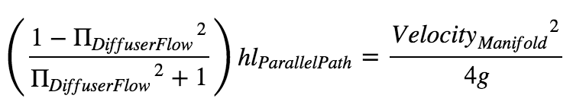
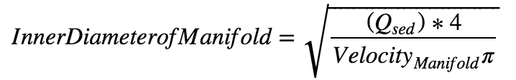
Inlet Manifold
Assumptions & Inputs
Sed tank dimensions
Exit head loss
Q_ratio
SDR
Inlet Manifold
Notes:
Analysis methods and description of key constraints:
Using head loss at the exit of the diffusers as design constraint for the design of the inlet manifold/diffuser system. This head loss in the exit of the diffuser will allow higher velocities (and pressure recovery) in the manifold pipe and thus will enable use of smaller diameter manifold pipes.
Diffusers
Maximum head loss in the sedimentation tank inlet is 1 cm
Nominal diameter of the sed tank diffuser = 1 inch
The diffuser pipes used in the sedimentation tank have an SDR of 26.
Stretch of the PVC pipes as they are heated and molded = 1.2
Upflow velocity at the top of the floc blanket (V_sed_up = 1 mm/s)
Inlet Manifold
Length of sed tank / PVC pipe used to make the inlet manifold = 6 m
Head loss exiting the tank is 5 cm
The manifold used in the sedimentation tank has an SDR of 41.
The minimum port flow (from the first port) divided by the maximum port flow (from the last port) for flow division between sedimentation tanks and for flow distribution from the inlet manifold should be at least: Q_ratio = 0.8
Plate Settlers:
Upflow velocity at the top of the floc blanket (V_sed_up = 1 mm/s)
Dimensions of the corrugated plastic sheets used to make the plate settlers:
Width = 42 inches
Thickness = 2 mm
Plate settlers angle = 60° from the horizontal
Plate setters spacing 2.5cm apart (this is the perpendicular distance between plates, not the horizontal)
Plate settler capture velocity = 0.12 mm/s
Orifices in the Outlet Manifold
Design temperature to calculate viscosity is 15 deg C
Minor loss coefficient to be K = 1
Vena contracta (VC) is 0.63
Spacing between orifices in the outlet manifold is 10 cm

Slide 6
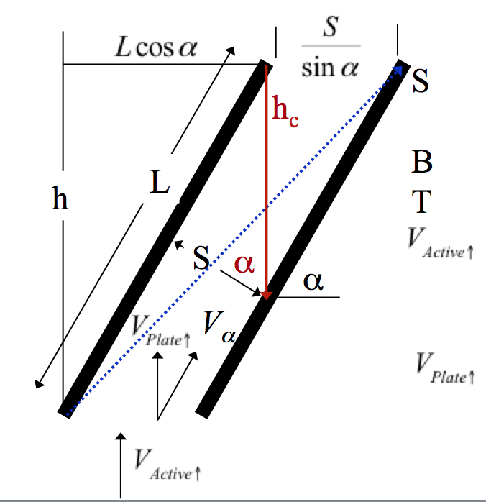
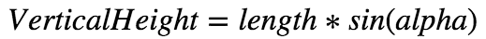
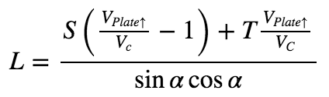
Plate Settlers
Assumptions & Inputs
Upflow velocity
Plastic sheet dimensions
Angle and spacing
Capture velocity
Plate Settlers
Notes:
Analysis methods and description of key constraints:
Using head loss at the exit of the diffusers as design constraint for the design of the inlet manifold/diffuser system. This head loss in the exit of the diffuser will allow higher velocities (and pressure recovery) in the manifold pipe and thus will enable use of smaller diameter manifold pipes.
Diffusers
Maximum head loss in the sedimentation tank inlet is 1 cm
Nominal diameter of the sed tank diffuser = 1 inch
The diffuser pipes used in the sedimentation tank have an SDR of 26.
Stretch of the PVC pipes as they are heated and molded = 1.2
Upflow velocity at the top of the floc blanket (V_sed_up = 1 mm/s)
Inlet Manifold
Length of sed tank / PVC pipe used to make the inlet manifold = 6 m
Head loss exiting the tank is 5 cm
The manifold used in the sedimentation tank has an SDR of 41.
The minimum port flow (from the first port) divided by the maximum port flow (from the last port) for flow division between sedimentation tanks and for flow distribution from the inlet manifold should be at least: Q_ratio = 0.8
Plate Settlers:
Upflow velocity at the top of the floc blanket (V_sed_up = 1 mm/s)
Dimensions of the corrugated plastic sheets used to make the plate settlers:
Width = 42 inches
Thickness = 2 mm
Plate settlers angle = 60° from the horizontal
Plate setters spacing 2.5cm apart (this is the perpendicular distance between plates, not the horizontal)
Plate settler capture velocity = 0.12 mm/s
Orifices in the Outlet Manifold
Design temperature to calculate viscosity is 15 deg C
Minor loss coefficient to be K = 1
Vena contracta (VC) is 0.63
Spacing between orifices in the outlet manifold is 10 cm

Slide 7
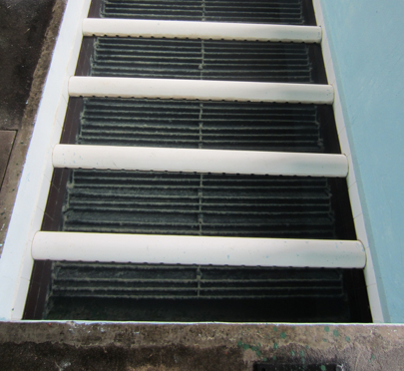
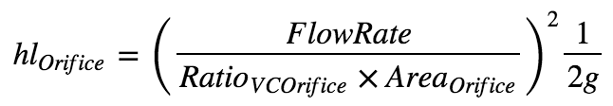
Orifices
Assumptions & Inputs
Vena contracta
Spacing
Length of Sed tank
Headloss_exit
Headloss_Inlet
Outlet Orifices
Notes:
Analysis methods and description of key constraints:
Using head loss at the exit of the diffusers as design constraint for the design of the inlet manifold/diffuser system. This head loss in the exit of the diffuser will allow higher velocities (and pressure recovery) in the manifold pipe and thus will enable use of smaller diameter manifold pipes.
Diffusers
Maximum head loss in the sedimentation tank inlet is 1 cm
Nominal diameter of the sed tank diffuser = 1 inch
The diffuser pipes used in the sedimentation tank have an SDR of 26.
Stretch of the PVC pipes as they are heated and molded = 1.2
Upflow velocity at the top of the floc blanket (V_sed_up = 1 mm/s)
Inlet Manifold
Length of sed tank / PVC pipe used to make the inlet manifold = 6 m
Head loss exiting the tank is 5 cm
The manifold used in the sedimentation tank has an SDR of 41.
The minimum port flow (from the first port) divided by the maximum port flow (from the last port) for flow division between sedimentation tanks and for flow distribution from the inlet manifold should be at least: Q_ratio = 0.8
Plate Settlers:
Upflow velocity at the top of the floc blanket (V_sed_up = 1 mm/s)
Dimensions of the corrugated plastic sheets used to make the plate settlers:
Width = 42 inches
Thickness = 2 mm
Plate settlers angle = 60° from the horizontal
Plate setters spacing 2.5cm apart (this is the perpendicular distance between plates, not the horizontal)
Plate settler capture velocity = 0.12 mm/s
Orifices in the Outlet Manifold
Design temperature to calculate viscosity is 15 deg C
Minor loss coefficient to be K = 1
Vena contracta (VC) is 0.63
Spacing between orifices in the outlet manifold is 10 cm

Slide 8
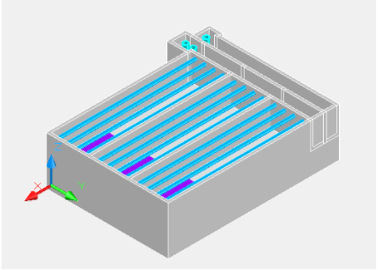

Applications
Input Parameters
Sed Tank Remainder
Channel Designs
Notes:
Applications we envision for the project:
As one part of the Sedimentation tank civil work design challenge component, these hydraulics-based functions for dimensions of the sedimentation tank remainder will expedite the design process when combined with the channel designs from the flocculator to the filters.

Slide 9
Further Development
Outlet Manifold
- Pipe diameter
Floc Blanket Design
Blanket height
Floc weir dimensions
Notes:
What we learned and recommendations for further development

Slide 10
Questions?
Resources:
Monroe
AIDE_design team

